Slide 1
DevOps

Slide 2
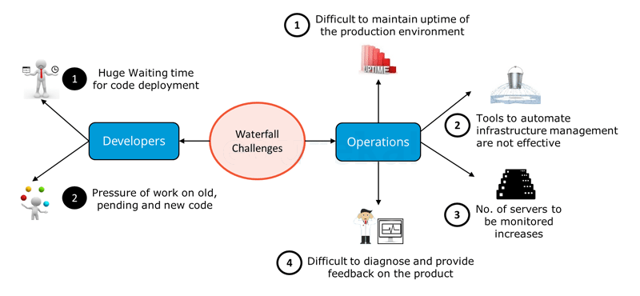
BACKGROUND-----Waterfall Model Challenges

Slide 3
BACKGROUND-----Waterfall Model Challenges
From Developers point of view there were majorly two challenges:
1 After Development, the code deployment time was huge.
2 Pressure of work on old, pending and new code was high because development and deployment time was high.

Slide 4
BACKGROUND-----Waterfall Model Challenges
On the other hand, Operations was also not completely satisfied. There were four major challenges they faced as per the above diagram:
1 It was difficult to maintain ~100% up time of the production environment.
2 Infrastructure Automation tools were not very Effective.
3 Number of severs to be monitored keeps on increasing with time and hence the complexity.
4 It was very difficult to provide feedback and diagnose issue in the product.

Slide 5
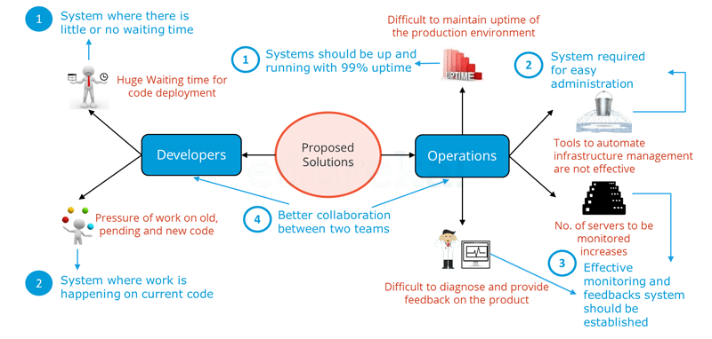
Proposed solution to the challenges of Waterfall Model

Slide 6
Probable Solutions for the issues faced by Developers and Operations
From Developers point of view:
1 A system which enables code deployment without any delay or wait time.
2 A system where work happens on the current code itself i.e. development sprints are short and well planned.

Slide 7
From Operations point of view:
1 System should have at-least 99% uptime.
2 Tools & systems are there in place for easy administration.
3 Effective monitoring and feedbacks system should be there.
4 Better Collaboration between Development & Operations and is common requirement for Developers and Operations team.

Slide 8
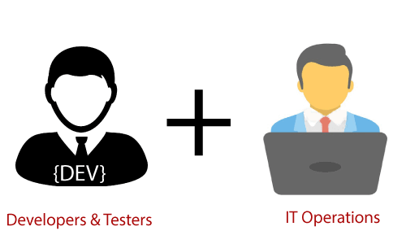
What exactly is DevOps?
It is nothing but the practice or methodology of making ‘Developers’ and the ‘Operations’ team work together.

Slide 9
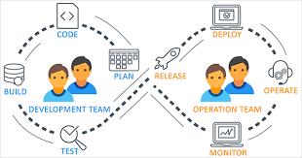
What is DevOps?
DevOps is a software development practice that promotes collaboration between development and operations, resulting in faster and more reliable software delivery. Commonly referred to as a culture, DevOps connects people, process, and technology to deliver continuous value.

Slide 10
According to the DevOps culture, a single group of Engineers (developers, system admins, QA’s. Testers etc turned into DevOps Engineers) has end to end responsibility of the Application (Software) right from gathering the requirement to development, to testing, to infrastructure deployment, to application deployment and finally monitoring & gathering feedback from the end users, then again implementing the changes.

Slide 11
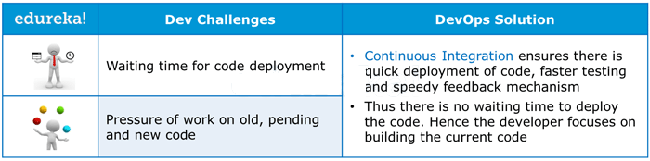
How DevOps addresses Dev Challenges.

Slide 12
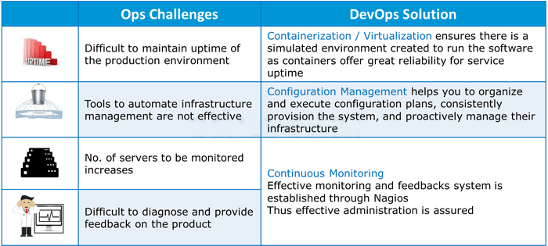
How DevOps addresses Ops Challenges.

Slide 13
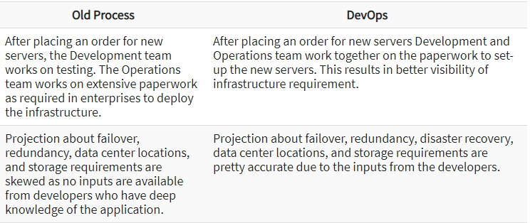
How is DevOps different from traditional IT

Slide 14
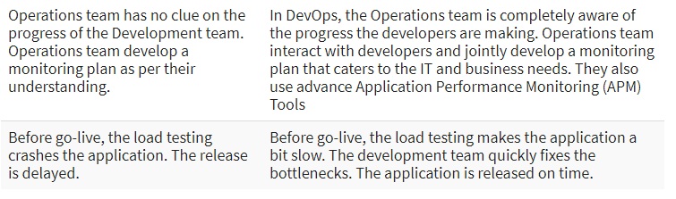
How is DevOps different from traditional IT

Slide 15
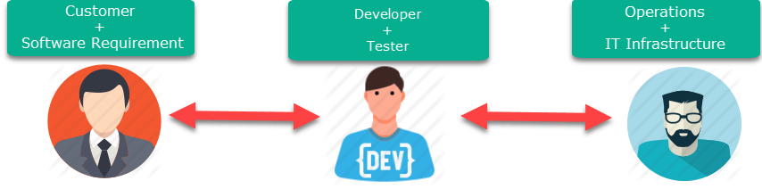
How is DevOps different from Agile? DevOps Vs Agile
Stakeholders and communication chain a typical IT process.

Slide 16
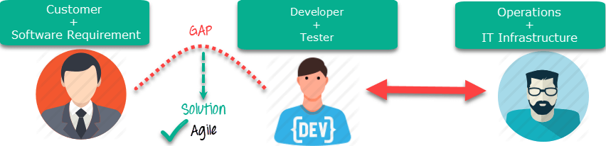
Agile addresses gaps in Customer and Developer communications

Slide 17
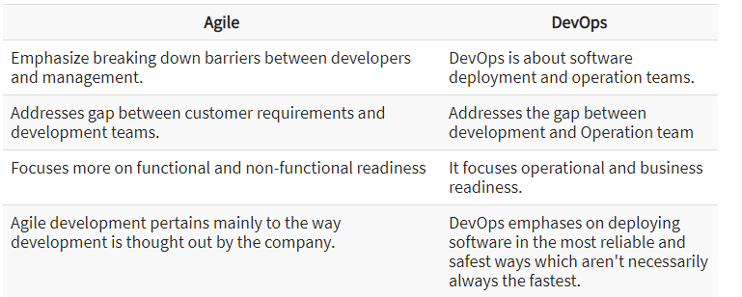
Agile vs DevOps

Slide 18
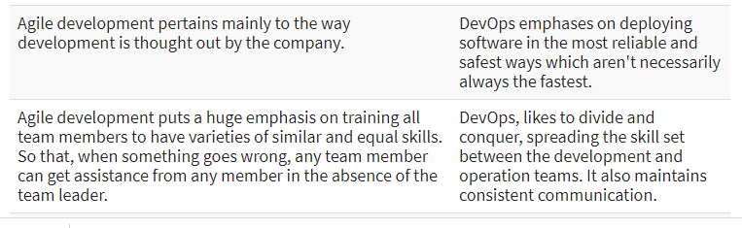
Agile vs DevOps

Slide 19
DevOps Principles
1. Customer-Centric Action: DevOps team must take customer-centric action for that they should constantly invest in products and services.
2. End-To-End Responsibility: The DevOps team need to provide performance support until they become end-of-life. This enhances the level of responsibility and the quality of the products engineered.
3. Continuous Improvement: DevOps culture focuses on continuous improvement to minimize waste. It continuously speeds up the improvement of product or services offered.

Slide 20
DevOps Principles
4. Automate everything: Automation is a vital principle of DevOps process. This is not only for the software development but also for the entire infrastructure landscape.
5. Work as one team: In the DevOps culture role of the designer, developer, and tester are already defined. All they needed to do is work as one team with complete collaboration.
6. Monitor and test everything: It is very important for DevOps team to have a robust monitoring and testing procedures.

Slide 21
When not to adopt DevOps?
It should not be used in a mission-critical application like bank, power and other sensitive data sites. Such applications need strict access controls on the production environment, a detailed change management policy, access control policy to the data centers.

Slide 22
When to adopt DevOps?
DevOps should be used for large distributed applications such as eCommerce sites or applications hosted on a cloud platform.

Slide 23
Industry Importance of DevOps
-----Shorter Development Cycles, Faster Innovation
When development and operations teams are in separate silos, it’s usually difficult to tell if an application is ready for operations. When development teams simply turn over an application, the operations’ cycle times are extended needlessly.
With a combined development and operations team, applications are ready for use much more quickly. This is important, since companies succeed based on their ability to innovate faster than their competitors do. In fact, Kevin Murphy from Red Hat estimates that shorter development cycles translate to bringing an application to market 60 percent faster than with traditional approaches.

Slide 24
Reduced Deployment Failures, Rollbacks, and Time to Recover
Deployment failures is due to programming defects. The shorter development cycles with DevOps promote more frequent code releases. This, in turn, makes it easier to spot code defects. Therefore, teams can reduce the number of deployment failures using agile programming principles that call for collaboration and modular programming. Rollbacks are similarly easier to manage because, when necessary, only some modules are affected.
Time to recover is an important issue, because some failure has to be expected. But recovery is much faster when the development and operations teams have been working together, exchanging ideas and accounting for both teams’ challenges during development.

Slide 25
Improved Communication and Collaboration
DevOps improves the software development culture. Combined teams are happier and more productive. The culture becomes focused on performance rather than individual goals. When the teams trust each other, they can experiment and innovate more effectively. The teams can focus on getting the product to market or into production, and their KPIs should be structured accordingly.
It’s no longer a matter of “turning over” the application to operations and waiting to see what happens. Operations doesn’t need to wait for a different team to troubleshoot and fix a problem. The process becomes increasingly seamless as all individuals work toward a common goal.

Slide 26
Increased Efficiencies
Scalable infrastructures, such as cloud-based platforms, increase the access the team has to hardware resources. As a result, testing and deployment operations speed up.
Build acceleration tools can be used to compile code more quickly.
Parallel workflows can be embedded into the continuous delivery chain to avoid delays; one team waits for another to complete its work.
Using one environment avoids the useless task of transferring data between environments. This means you don’t have to use one environment for development, a different environment for testing, and a third for deployment.

Slide 27
Reduced Costs and IT Headcount
All of the DevOps benefits translate to reduced overall costs and IT headcount requirements. According to Kevin Murphy from Red Hat, DevOps development teams require 35 percent less IT staff and 30 percent lower IT costs.

